Slide 1
COGS 9 - Introduction to Data Science
Winter 24
Discussion Section 4

Slide 2
Today’s Agenda
Paper 1: Tidy Data
Paper 2: Data Organization in Spreadsheets
Project Discussion / Q&A

Slide 3

Reading: Tidy Data
80% of time are spent on data cleaning and preparation
Tidy: a standardized way to link the structure of a dataset (its physical layout) with its semantics (its meaning)
This makes it easier to develop tidy tools for data analysis, regardless of technical domain, the application of the tools should be easy (e.g., plotting x vs y, or doing a regression)
Notes:
It is not the just the first step but must be repeated many times over the course of analysis
The principles of tidy data provide a standard way to organize data values within a dataset and to link the structure of a dataset (its physical layout) with its semantics (its meaning)

Slide 4
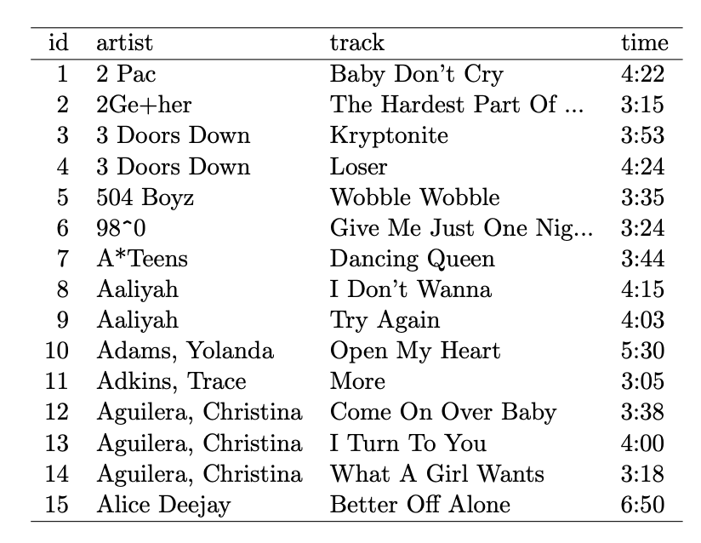
Principles of Tidy Data
A dataset is a collection of values that can include numbers or words
Each value in a dataset belongs to an observation, variable pair :
Each variable forms a column
Each observation forms a row
Each type of observational unit forms a table
Makes it easy for an analyst or computer to extract required information

Slide 5
Common Mistakes
Column headers are values, not variable names.
Multiple variables are stored in one column.
Variables are stored in both rows and columns.
Multiple types of observational units are stored in the same table.
A single observational unit is stored in multiple tables.

Slide 6
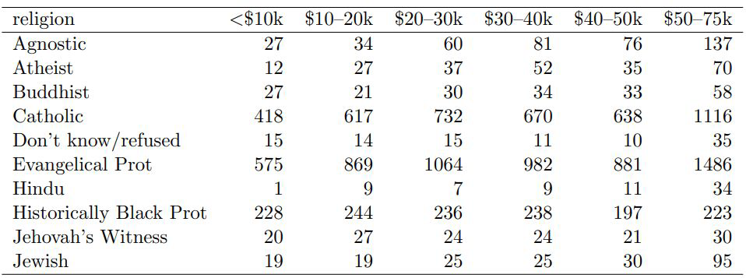
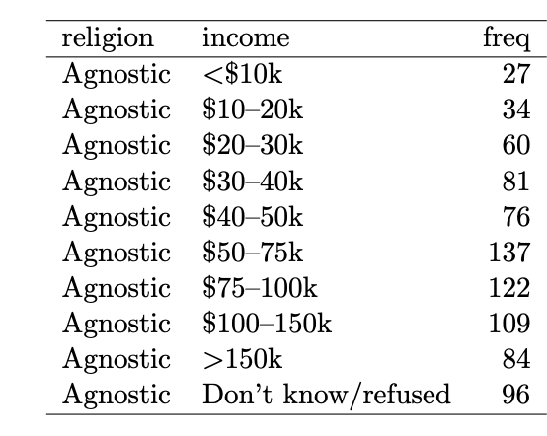
Column headers are values not variable names
Messy - wide form
Tidy - same information in a different format
Notes:
This example violates #1: the column headers are values, rather than variables.
We need to explicitly create the variable column (income)
Then melt those values in the header into that column, thus turning the wide dataset, long (here, molten)

Slide 7
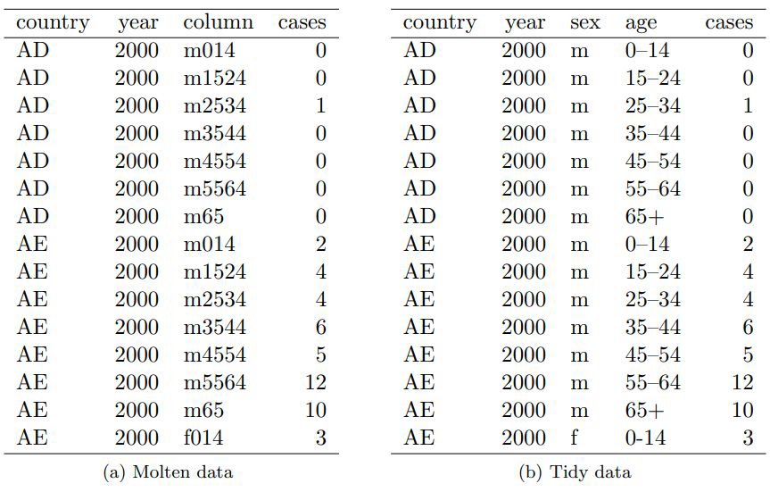
Multiple variables stored in one column
Notes:
Dataset: World Health Organization records on the counts of tuberculosis cases by country, year, and demographic
Code Example of Melting and Tidying

Slide 8
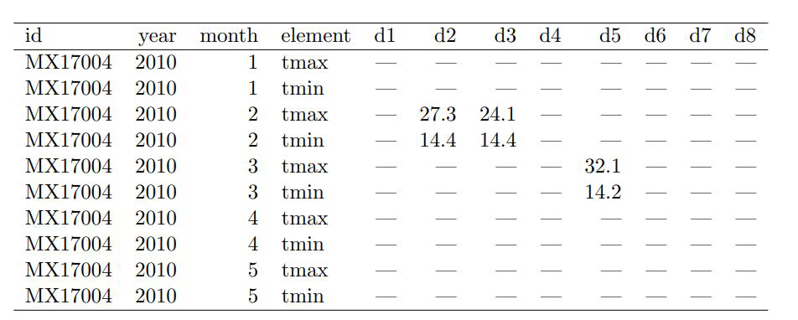
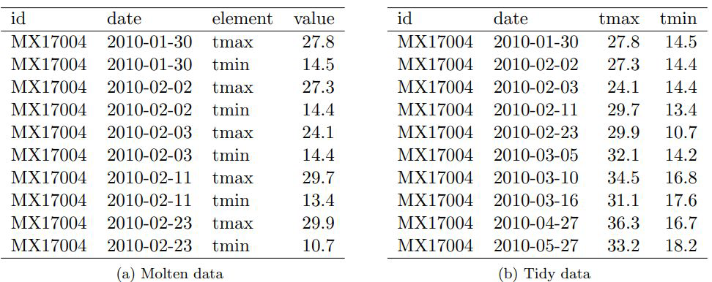
Variables are stored in both rows and columns
Notes:
We have date variable (year, month, d1 through d31) and tmax and tmin variable stored as element

Slide 9
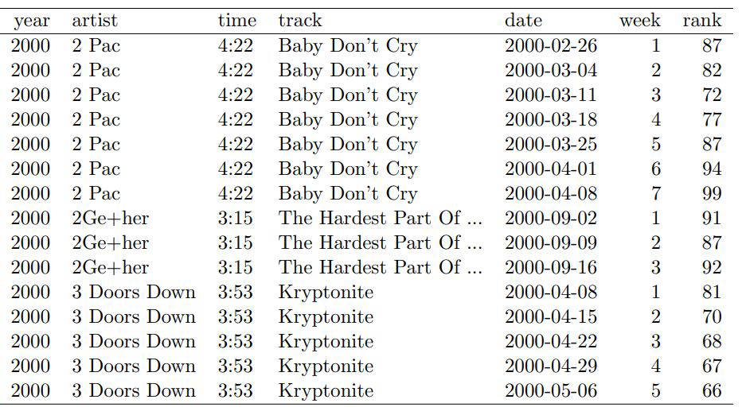
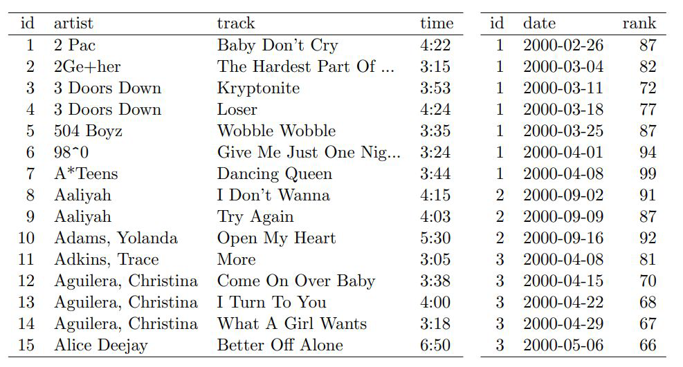
Multiple types in one table
Contains observations on 2 units: song and rank in each week – artist & time repeated
2 different datasets – song dataset and ranking dataset
Notes:
The Billboard dataset described in Table 8 actually contains observations on two types of observational units: the song and its rank in each week. This manifests itself through the duplication of facts about the song: artist and time are repeated for every song in each week. The Billboard dataset needs to be broken down into two datasets: a song dataset which stores artist, song name and time, and a ranking dataset which gives the rank of the song in each week.

Slide 10
One type in multiple tables
Data values about a single type of observational unit spread out over multiple tables or files.
These tables and files are often split up by another variable, so that each represents a single year, person, or location. E.g. – different files for each month, titled Jan 2024, Feb 2024 and so on
If all files are consistent in format – add a column to each table representing the file name (since that is usually an important variable), combine all files into a single table
If inconsistent files – individual tidying of files, make variables, formats and conventions consistent in all, then merge

Slide 11

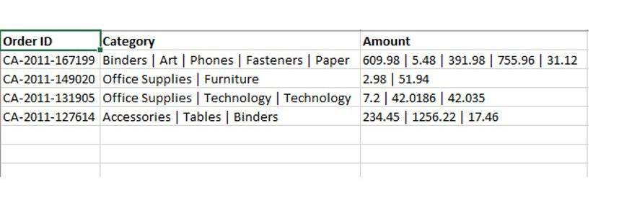
Practice
Make sure you fill out the attendance form:
Why is this dataset messy? How can you improve it?

Slide 12
Reading: Data Organization in Spreadsheet
Spreadsheets and data frames are widely used for data entry, storage, and analysis
Good spreadsheets are less error-prone, easier for computers to process, and easier to share with collaborators
Standardized data storage allows for open-source analysis tools that work on your data straight out of the box. Huge time saver.
This guide outlines key practices for organizing spreadsheet data effectively to minimize errors and improve analysis.

Slide 13
Consistency
Use consistent codes for categorical variables – E.g., male/female vs M/F
Use a consistent fixed code for any missing values:
Every cell should be filled – distinguish between truly missing & unintentionally missing values
Could use hyphen (-), NA, N/A; avoid using numbers like -999 or 999
Use consistent variable names across files – E.g., “Glucose_10wk” vs “gluc_10weeks”
Use consistent subject identifiers – E.g., ”Mouse153” vs “153” vs “Mouse-153F”
Notes:
Capitalization also matters

Slide 14
Consistency
Use a consistent data layout in multiple files – easy to combine multiple files
Use consistent file names – E.g., “Serum batch1 2015-01-30.csv” vs “batch2 serum 52915.csv”
Use a consistent format for all dates – standard format is YYYY-MM-DD
Use consistent phrases in your notes – E.g., “dead” vs “Dead”, “lo off curve” vs ”off curve lo”
Be careful about extra spaces within cells – E.g., Blank cell vs a cell with space, “male “ vs “ male ”

Slide 15
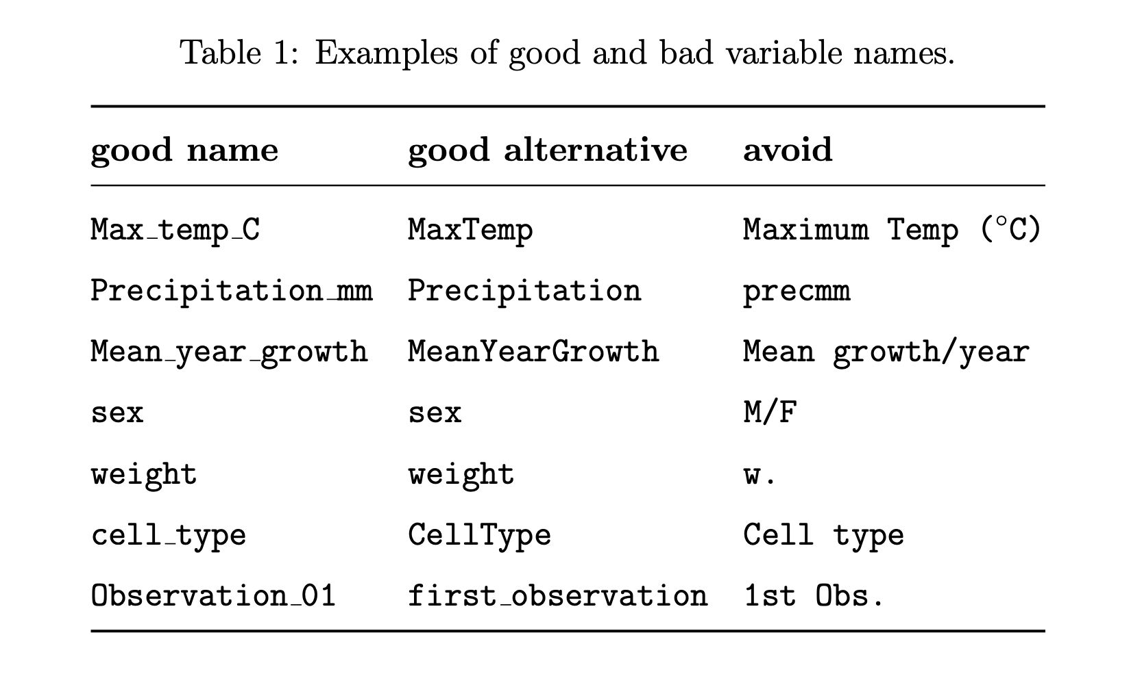
Good names for things
Avoid spaces – makes programming harder
Use either underscores or hyphens
Avoid other special characters
Name should be short but meaningful
Try not to include “final “ in file name

Slide 16
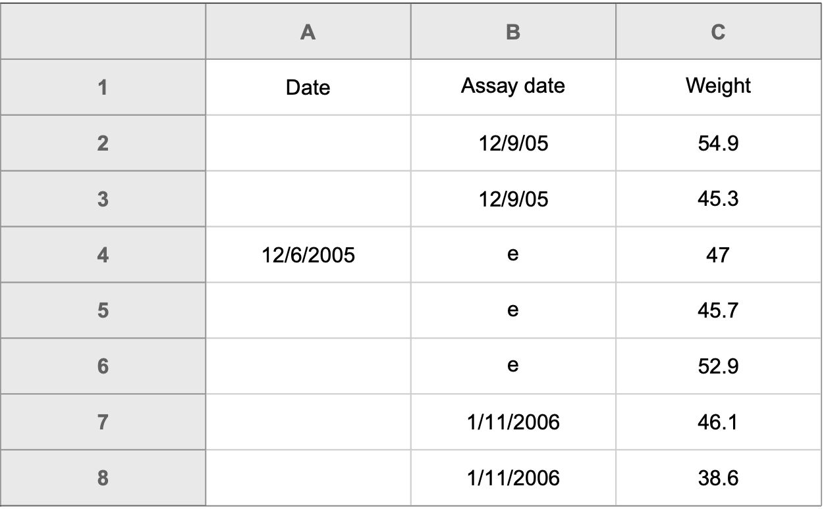
Date Formats
ISO 8601 Standard - YYYY-MM-DD
prefer to use a plain text format for columns in an Excel worksheet that are going to contain dates
Another way in excel is to begin the date with an apostrophe - '2014-06-14
A spreadsheet with inconsistent date formats
Notes:
We often prefer to use a plain text format for columns in an Excel worksheet that are going to contain dates, so that it doesn’t do anything to them.
However, if you do this on columns that already contain dates, Excel will convert them to a text value of their underlying numeric representation. Another way to force Excel to treat dates as text is to begin the date with an apostrophe, like this: '2014-06-14

Slide 17
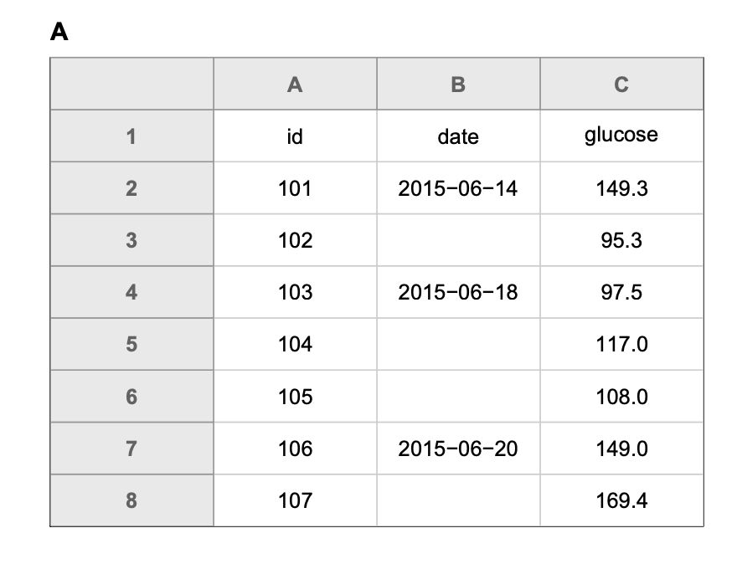
No empty cells
“NA” or a hyphen
Don’t let people assume repetition

Slide 18
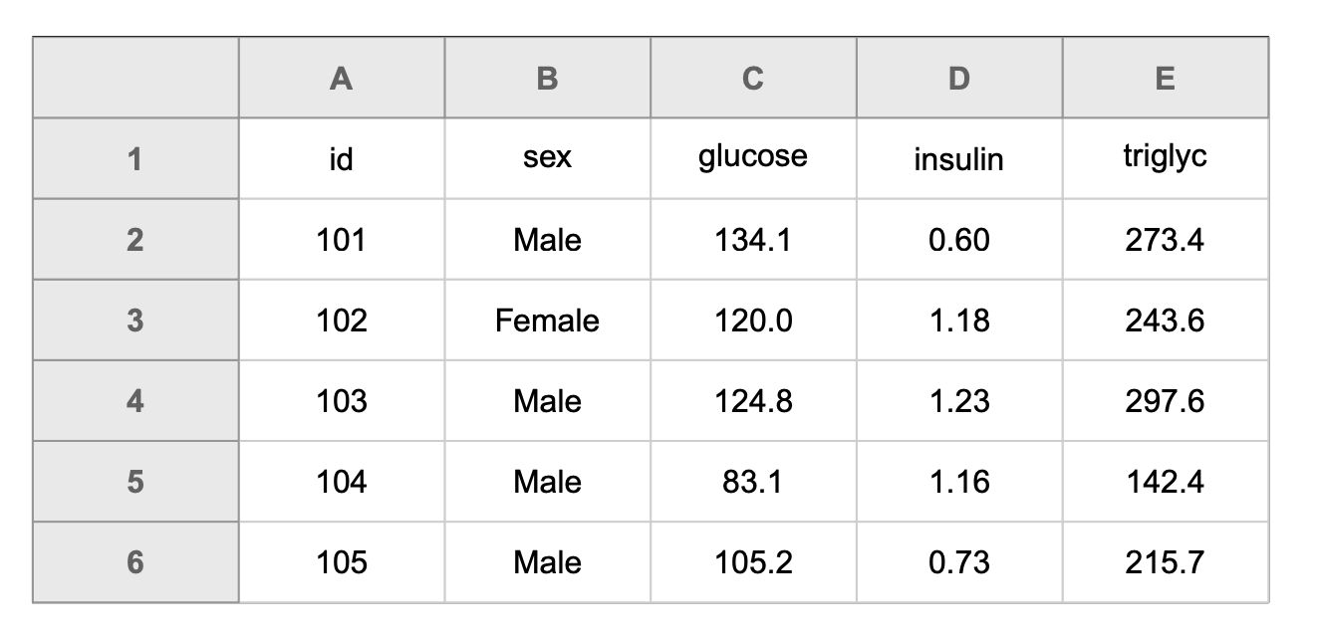
One thing in a cell

Slide 19
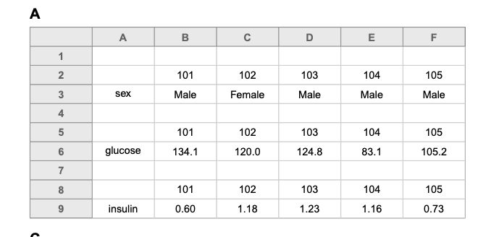
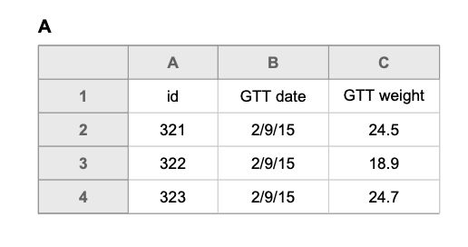
Make it a rectangle
Notes:
Examples of spreadsheets with non-rectangular layouts. These layouts are likely to cause problems in analysis.
Reorganization of Figure 5D as a pair of rectangles.

Slide 20
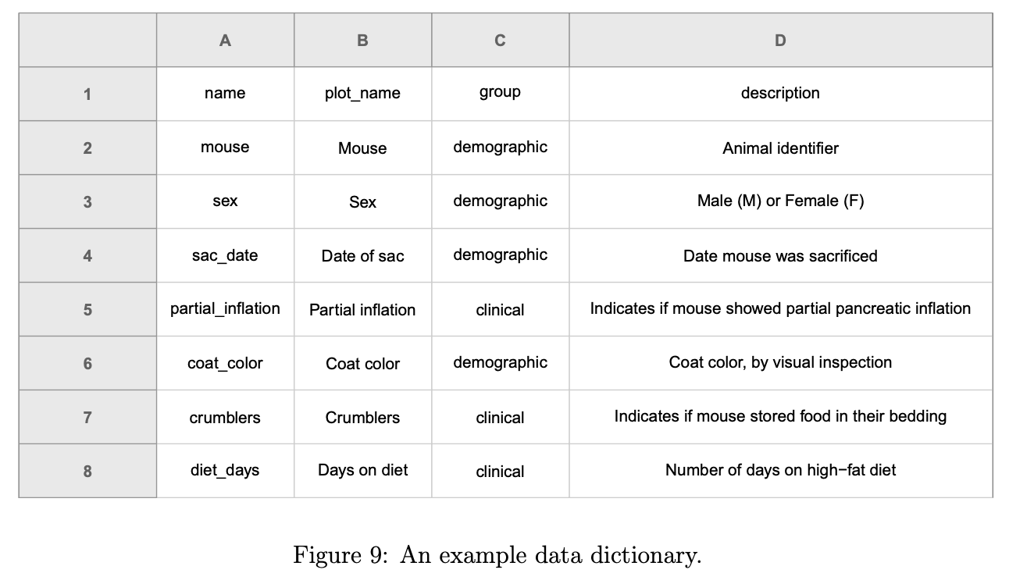
Create a data dictionary
The exact variable name as in the data file
A version of the variable name that might be used in data visualizations
A longer explanation of what the variable means
The measurement units
Expected minimum and maximum values

Slide 21
No calculations in raw data file
Primary data file should contain just the data and nothing else: no calculations, no graphs
If you want to do some analyses in Excel, make a copy of the file and do your calculations and graphs in the copy

Slide 22
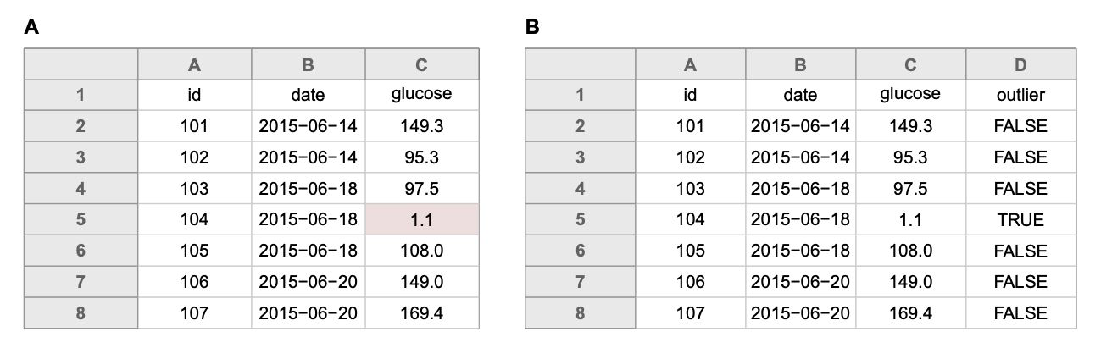
Don’t use font color or highlighting as data
Notes:
A is highlighting potential outlier, B is the preferred method ( csv files don’t store the highlighting information, data can be lost)

Slide 23
Backup & Data Validation
Make backups (write-protect the file if not actively entering data)
Use data validation to avoid errors
In excel , Select a column
In the menu bar, choose Data → Validation
Choose appropriate validation criteria
A whole number in some range
A decimal number in some range
A list of possible values
Text, but with a limit on length
Save the data in plain text files – E.g., csv, tab delimited text

Slide 24
Use the rest of the time to begin working on your projects, feel free to come and discuss with us anything related to quizzes, assignments or project
Questions?

